Slide 1
Sunlight Sensor
Raphael Najera
n01104031

Slide 2
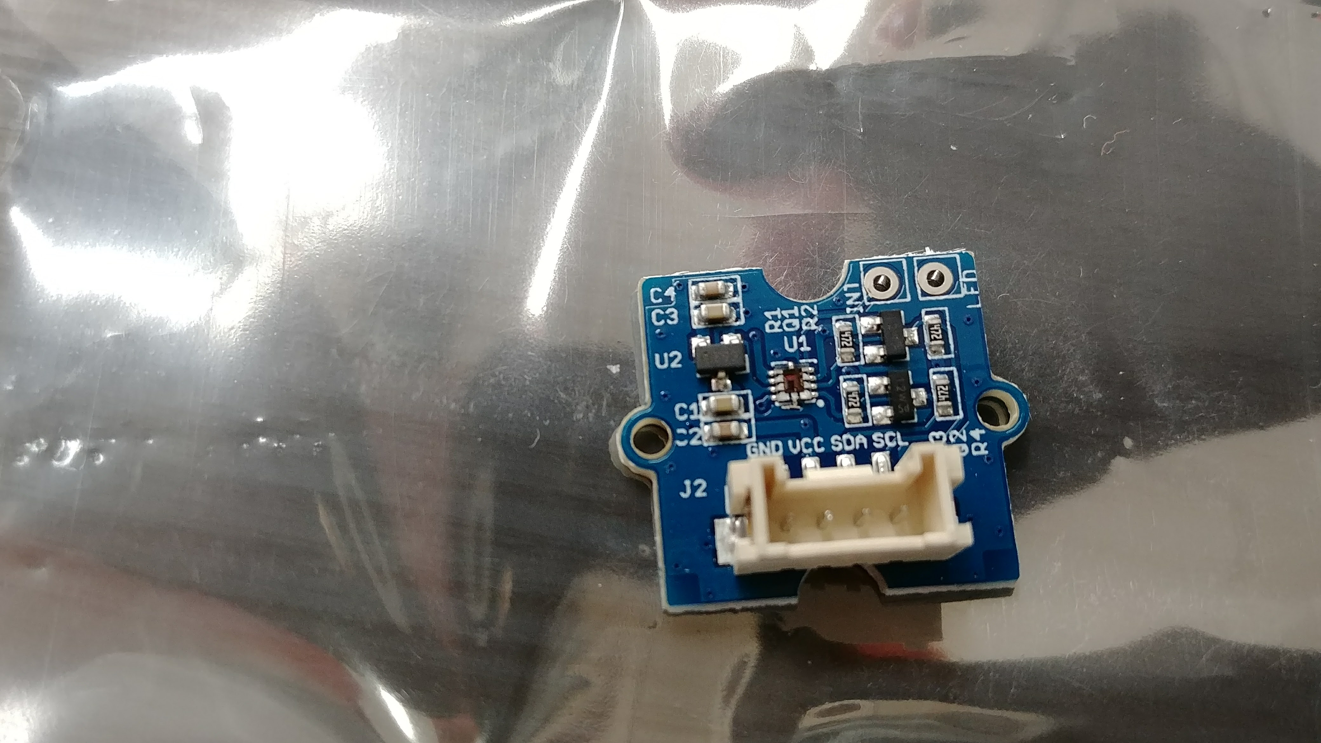
Introduction (Proposal)
Display Visible Light (Vis), Infrared Light (IR), UV-Light
Measure Vis, IR in Lumens
Useful information for finding out the UV-Index based on UV-Light
Finding out VI, IR, UV from the sunlight

Slide 3
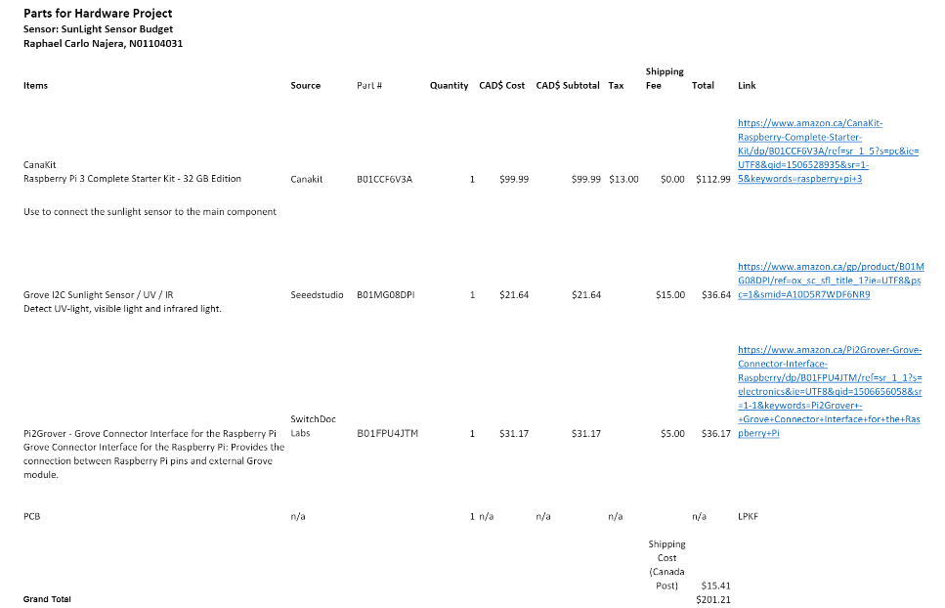
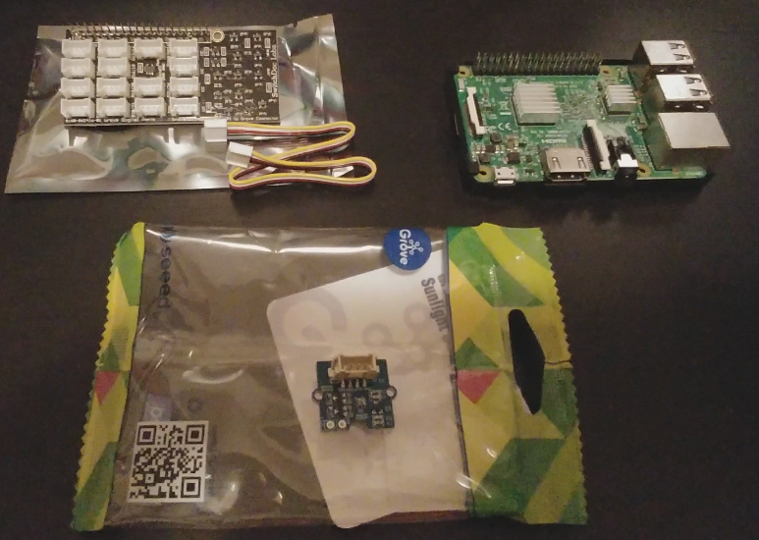
Budget
Raspberry Pi 3 ($112.99)
Sunlight Sensor ($36.64)
Connector interface ($36.17)
Shipping ($15.43)
Total Cost: ($201.23)

Slide 4
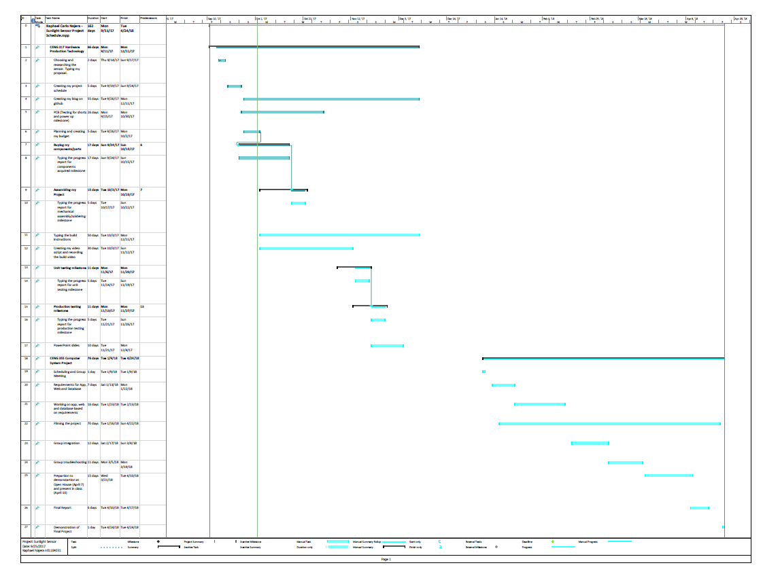
Project Schedule
Proposal (Sept 11 – 18)
Schedule Plan (Sept 18 – 25)
Budget Plan (Sept 25 – Oct 2)
Ordering the parts
Setting up the pi and code
Connection the sunlight sensor
Testing the sunlight sensor (Oct 16 – Dec 11)
Build script/video (Dec 4 – 18)
Progress Report (Dec 18 – Jan 8)
Build Instruction (Jan 15 – 22)

Slide 5
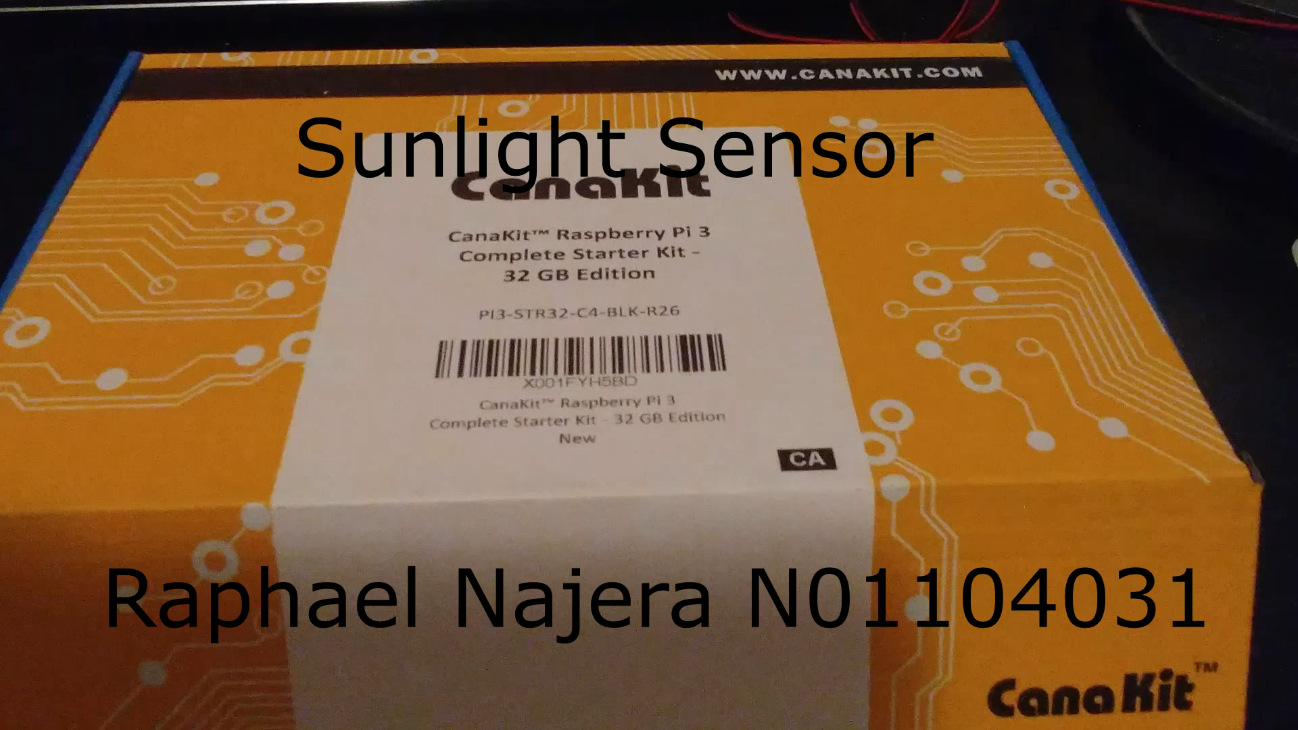
Demo/Build Video

Slide 6
Course knowledge utilized from previous courses
CENG 216 Introduction to Software Engineering – Learning about Gantt chart/project schedule
CENG200 Unix Scripting – learning unix cmds. For example, ls, nano
Writ 220 Technical Workplace Writing – Writing reports, build instruction
CENG 254 Database with Java – Setting up the database, saving data to the database

